Slide 1
Spring Boot Series – Day 5
Topic: Spring Boot Actuator
@CodeByHaindavi | #SpringWithMe

Slide 2
What is Spring Boot Actuator?
✔️ A built-in module in Spring Boot for monitoring and managing your application.
✔️ Gives you production-ready features — no extra setup or tools needed.
✔️ Think of it like a health dashboard for your app — but with powerful tools too.
@CodeByHaindavi | #SpringWithMe

Slide 3
Why Use Spring Boot Actuator?
🩺 Check if your app is healthy without opening the code.
📊 Access performance and usage metrics instantly.
🔍 Explore your beans, environment, properties, and configs.
✅ Perfect for debugging and for cloud deployments like Kubernetes or AWS.
@CodeByHaindavi | #SpringWithMe

Slide 4
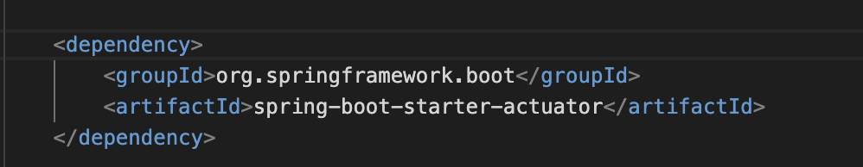
Adding Actuator to Your Project
✔️ Include this dependency in your pom.xml or Spring Initializr:
✔️ `spring-boot-starter-actuator`
✔️ That's it. Spring Boot will auto-configure actuator endpoints.
@CodeByHaindavi | #SpringWithMe

Slide 5
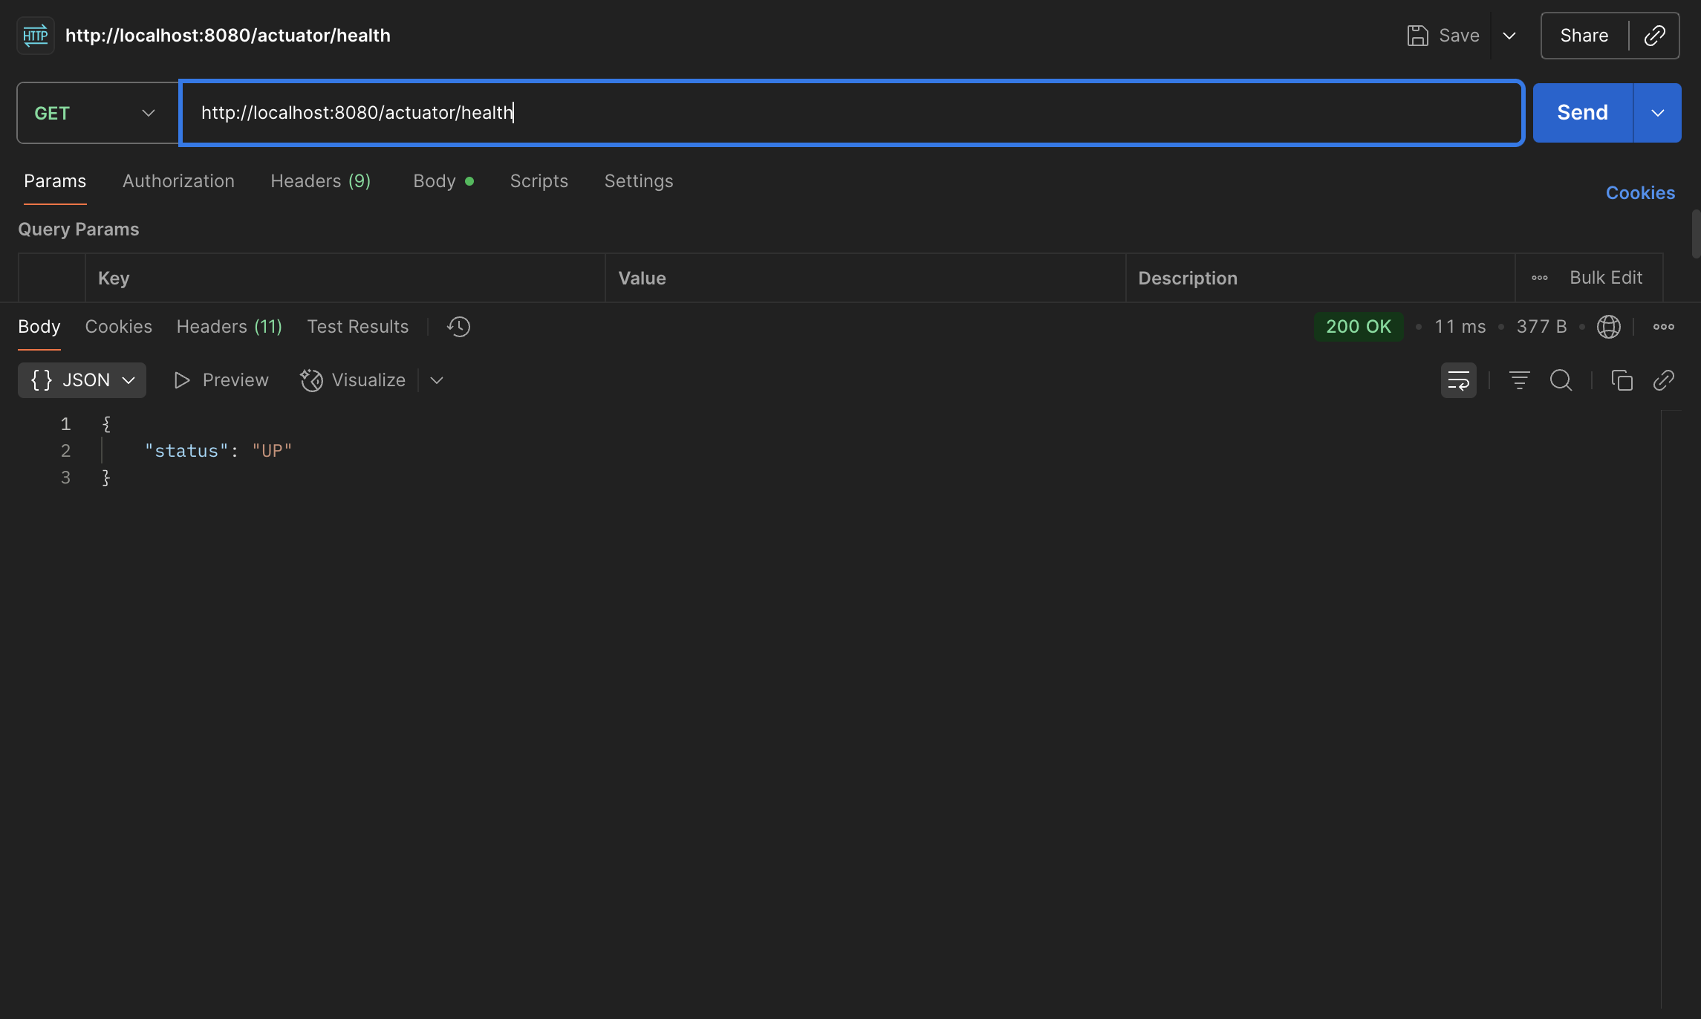
Common Built-in Endpoints
✔️ /actuator/health – Shows if your app is up.
@CodeByHaindavi | #SpringWithMe

Slide 6
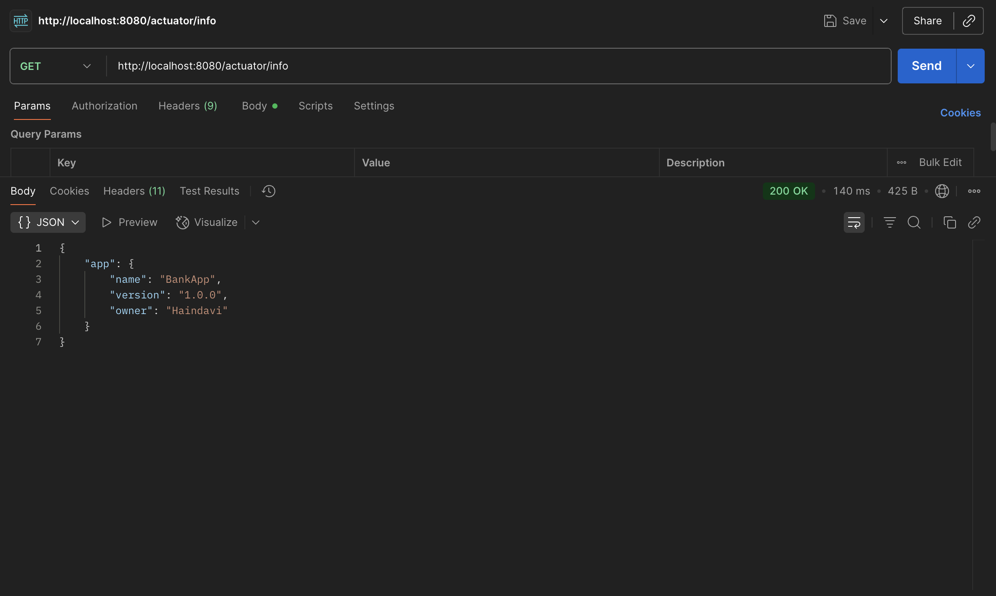
Common Built-in Endpoints
✔️ /actuator/info – Displays app info from properties.
@CodeByHaindavi | #SpringWithMe

Slide 7
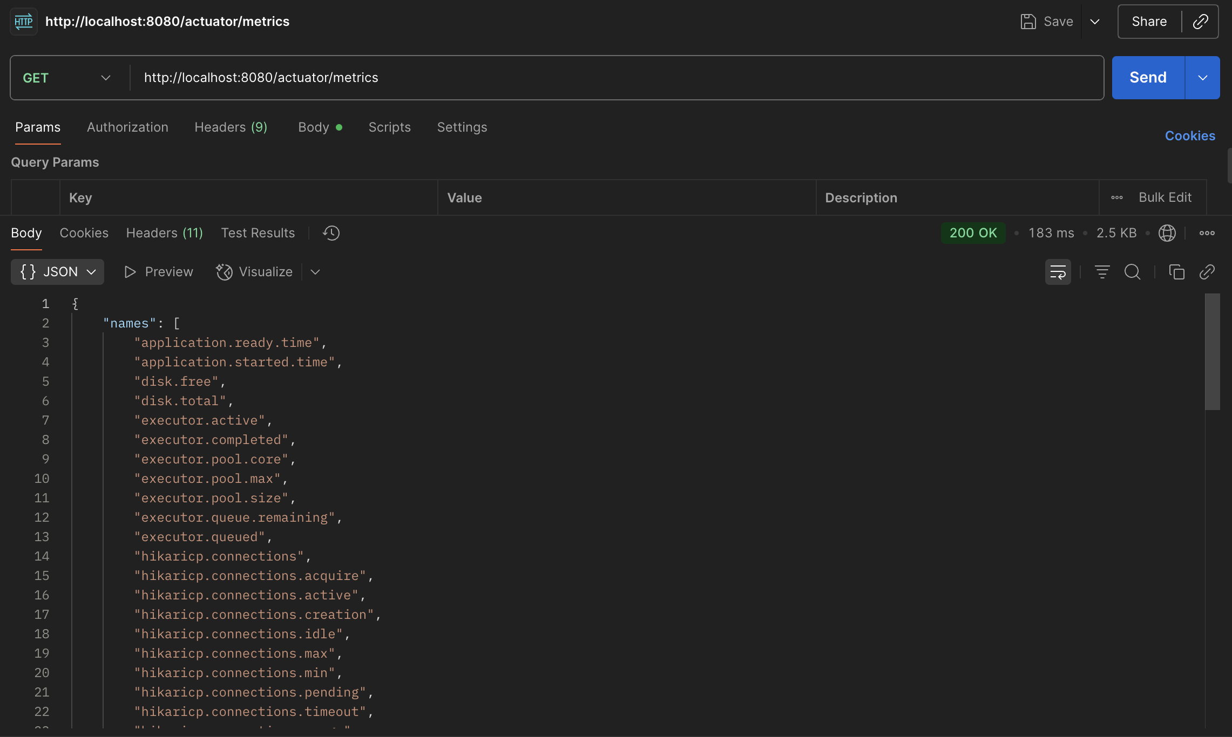
Common Built-in Endpoints
✔️ /actuator/metrics – Performance stats (like JVM memory, HTTP calls).
@CodeByHaindavi | #SpringWithMe

Slide 8
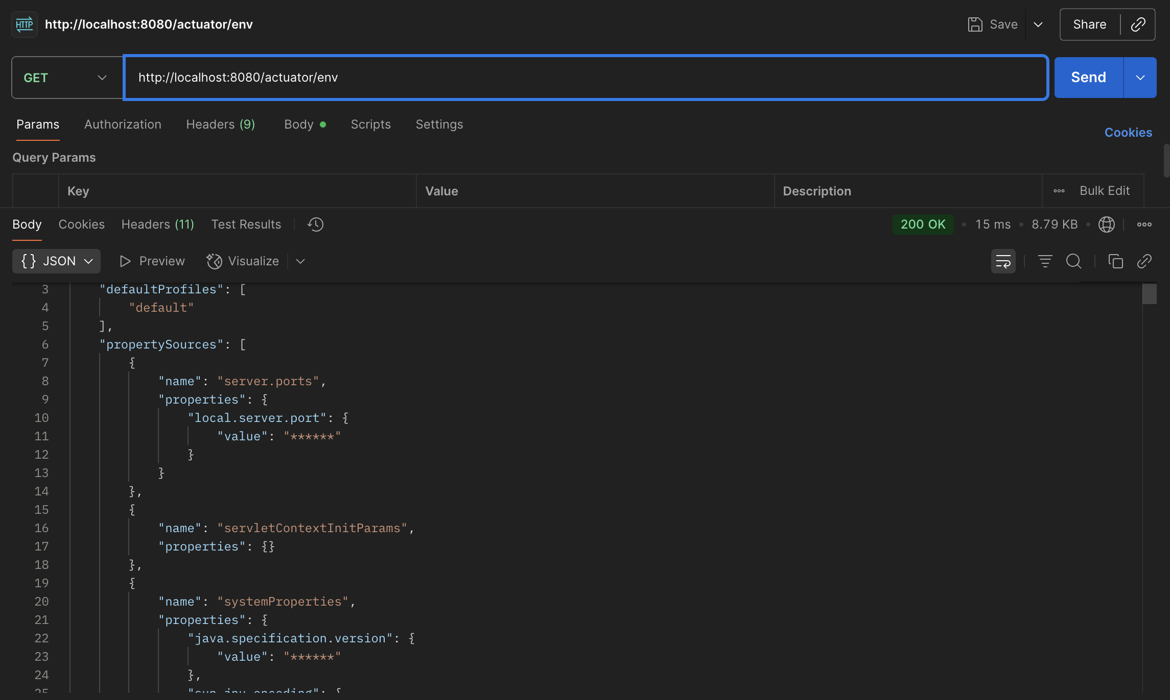
Common Built-in Endpoints
✔️ actuator/env – Shows all environment properties.
@CodeByHaindavi | #SpringWithMe

Slide 9
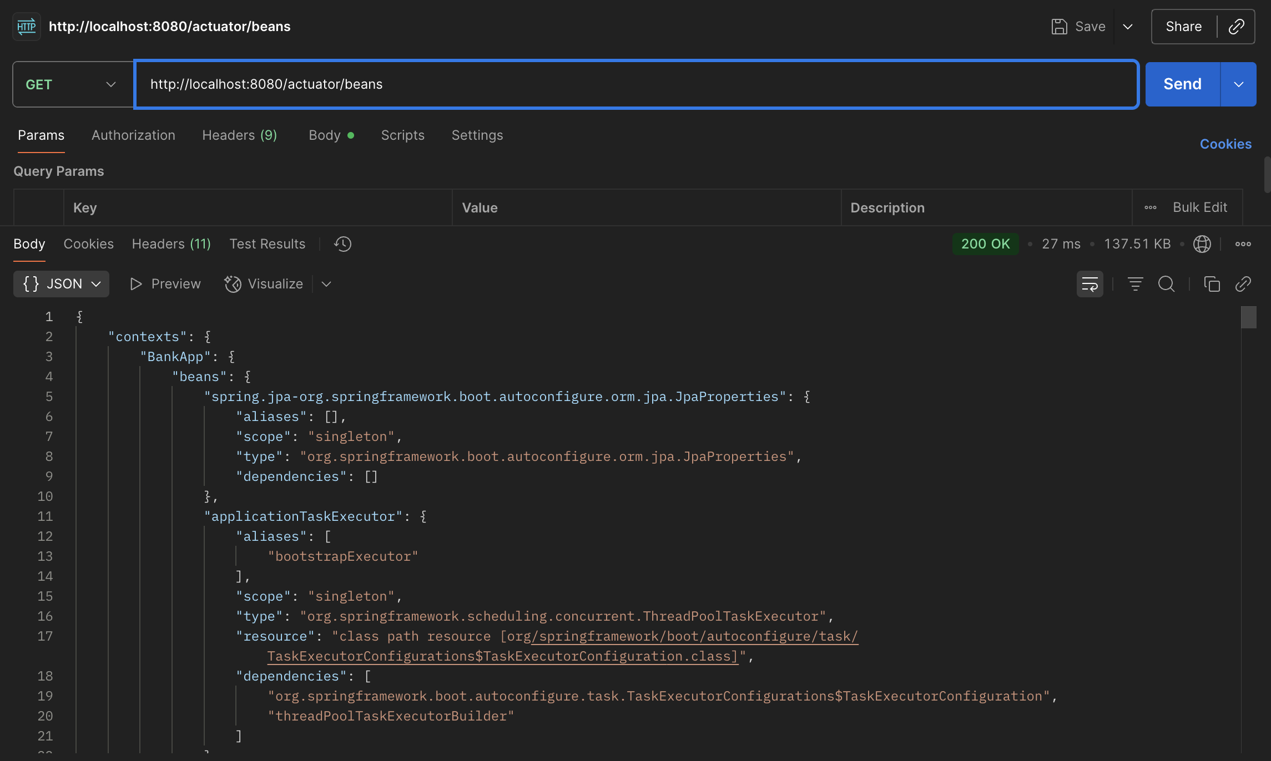
Common Built-in Endpoints
✔️ actuator/beans – Lists all Spring-managed beans.
@CodeByHaindavi | #SpringWithMe

Slide 10
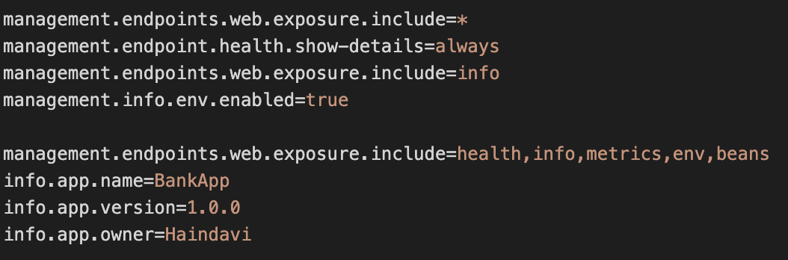
Enable/Expose Endpoints
✔️By default, only `/health` and `/info` are exposed.
✔️To enable more, use this in application.properties:
✔️management.endpoints.web.exposure.include=health,info,metrics,env
✔️To expose everything (not recommended in prod):
✔️management.endpoints.web.exposure.include=*
@CodeByHaindavi | #SpringWithMe

Slide 11
Customizing /actuator/info
✔️Add app-specific info to your Actuator’s `/info` endpoint:
✔️ application.properties:
✔️ info.app.name=BankingApp
✔️ info.app.version=1.0.0
✔️ Useful for versioning or debugging in deployed environments.
@CodeByHaindavi | #SpringWithMe

Slide 12
Securing Actuator Endpoints
✔️Actuator exposes sensitive info. Never leave them open.
Options:
✔️ Use Spring Security to protect Actuator URLs.
✔️ Or disable endpoints in prod:
✔️ management.endpoint.beans.enabled=false
@CodeByHaindavi | #SpringWithMe

Slide 13
Real-World Use Cases
🔁 ELB health checks using /actuator/health
📈 Monitoring memory/CPU in real time via /metrics
⚙️ Checking app version on a live server using /info
📦 Integrating with Prometheus/Grafana for dashboards
@CodeByHaindavi | #SpringWithMe

Slide 14
💼 Interview Insight
How do you expose Actuator endpoints securely in production?
• Use Spring Security + expose only required endpoints via properties.
Can you monitor performance without writing code?
• Yes — Actuator + Micrometer integration enables metrics export out-of-the-box.
Can Actuator endpoints be filtered or disabled?
• Yes — use management.endpoints.web.exposure.include or exclude in application.properties to control exactly what’s available.
@CodeByHaindavi | #SpringWithMe

Slide 15
📌 Recap – Day 5
✔️ What Spring Boot Actuator is and why it matters
✔️ Common endpoints and how to expose them
✔️ Securing and customizing Actuator in real apps
✔️ Real interview questions and deployment scenarios
👉 Coming up next: Spring Boot DevTools & Profiles✨
@CodeByHaindavi | #SpringWithMe

